Slide 1


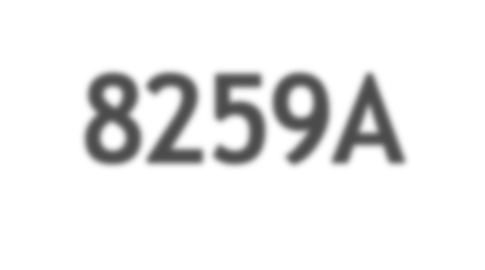









Presented By
NVDP Murthy

Slide 2


Introduction
Features
Pin Diagram
Block Diagram
Description of blocks

Slide 3


PIC A special purpose integrated circuit that function as an overall manager in an interrupt driven system.
It accepts request from the peripheral equipment,determines which of the incoming request is of the highest priority, ascertains whether the incoming request has a higher priority value than the level currently being serviced, and issues an interrupt to the CPU based on this determination.
PICs typically have eight interrupt lines, and two PICs are often cascaded to provide 15 available interrupt lines

Slide 4

8 levels of interrupts.
Can be cascaded in master-slave configuration to handle 64 levels of interrupts.
Internal priority resolver.
Fixed priority mode and rotating priority mode.
Individually maskable interrupts.
Modes and masks can be changed dynamically.
Accepts IRQ, determines priority, checks whether incoming priority > current level being serviced, issues interrupt signal.
In 8085 mode, provides 3 byte CALL instruction. In 8086 mode, provides 8 bit vector number.
Polled and vectored mode.
Starting address of ISR or vector number is programmable.
No clock required.

Slide 5


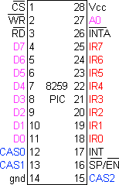

Slide 6
D0-D7 | Bi-directional, tristated, buffered data lines. Connected to data bus directly or through buffers.
RD-bar | Active low read control
WR-bar | Active low write control
A0 | Address input line, used to select control register.
CS-bar | Active low chip select
CAS0-2 | Bi-directional, 3 bit cascade lines. In master mode, PIC places slave ID no. on these lines. In slave mode, the PIC reads slave ID no. from master on these lines. It may be regarded as slave-select.
SP-bar / EN-bar | Slave program / enable. In non-buffered mode, it is SP-bar input, used to distinguish master/slave PIC. In buffered mode, it is output line used to enable buffers.
INT | Interrupt line, connected to INTR of microprocessor.
INTA-bar | Interrupt ack, received active low from microprocessor.
IR0-7 | Asynchronous IRQ input lines, generated by peripherals.

Slide 7
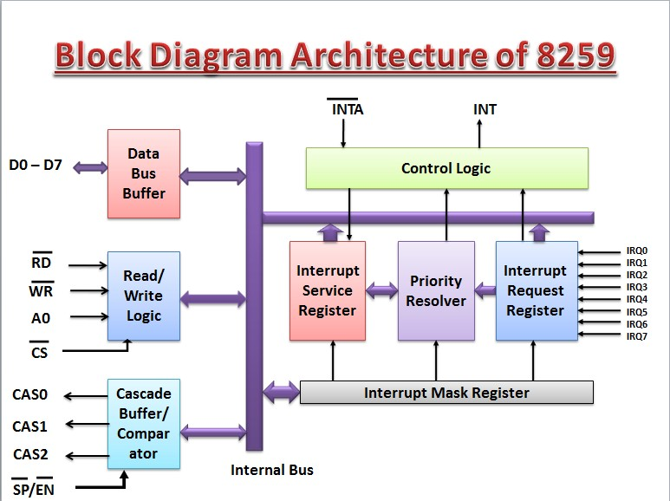

Slide 8
This 3- state, bidirectional 8-bit buffer is used to
interface the 8259 to the system data bus.
Control words and status information are transferred through the data bus buffer.

Slide 9

The function of this block is to accept OUTPUT
commands from the CPU.
It contains the initialization command word (ICW) register and operation command word (OCW) register which store the various control formats for device operation.
This function block also allows the status of 8259A to be transferred to the data bus.

Slide 10




IRR stores all the interrupt inputs that are requesting service.
Basically, it keeps track of which interrupt inputs are asking for service.
If an interrupt input is unmasked, and has an interrupt signal on it, then the corresponding bit in the IRR will be set.

Slide 11
The IMR is used to disable (Mask) or enable (Unmask)
individual interrupt inputs.
Each bit in this register corresponds to the interrupt input with the same number. The IMR operation on the IRR.
Masking of higher priority input will not affect the interrupt request lines of lower priority. To unmask any interrupt the corresponding bit is set ‘0’.

Slide 12

The in service registers keeps tracks of which interrupt
inputs are currently being serviced.
For each input that is currently being serviced the corresponding bit will be set in the in service register.
Each of these 3-reg can be read as status reg.

Slide 13
· This logic block determines the priorities of the set in the IRR.
· The highest priority is selected and strobed into the corresponding bit of the ISR during pulse.

Slide 14
This function blocks stores and compare the IDS of all 8259’s in the reg. The associated 3-I/O pins (CAS0- CAS2) are outputs when 8259 is used a master.
Master and are inputs when 8259 is used as a slave. As a master, the 8259 sends the ID of the interrupting slave device onto the cas2-cas0.
The slave thus selected will send its pre-programmed subroutine address on to the data bus during the next one or two successive pulses.

Slide 15


